Slide 1


Christ University
CRYPTOTRACK PRO
Empowering Your Cryptocurrency Journey
Java Presentation
Department of Computer Science

Slide 2

Table of
CONTENTS
01
02
03
04
Introduction
Key Features:
Sample Code
Output
05
06
Insights
Conclusion

Slide 3

INTRODUCTION
Cryptocurrencies have revolutionized finance, demanding efficient tracking and analysis tools.
Investors struggle with the decentralized and volatile nature of cryptocurrency data.
CryptoChecker emerges as a centralized solution offering real-time tracking, analysis, and portfolio management.
Its customizable features and actionable insights empower users for confident decision-making.

Slide 4

KEY FEATURES
01
Unique Features
02
Real-time Tracking
Explore CryptoChecker's customizable dashboards and advanced analytics.
Witness live updates on cryptocurrency prices, market trends, and portfolio performance.
03
Comprehensive Analysis
04
User-friendly Interface
Dive deep into historical data, market sentiment analysis, and predictive modeling.
Enjoy a sleek and intuitive design, suitable for both novice and experienced users.

Slide 5
KEY FEATURES
INTEGRATION CAPABILITIES
SECURITY MEASURES
SCALABILITY
CONTINUOUS DEVELOPMENT
Seamlessly integrate CryptoChecker with various exchanges and wallets for streamlined data management.
Learn about CryptoChecker's robust security protocols to ensure the safety of user data and assets.
Discover how CryptoChecker can scale to accommodate the needs of individual investors, traders, and institutional clients.
Stay informed about ongoing updates and enhancements to CryptoChecker's features and functionalities.

Slide 6


SAMPLE CODE SNIPPETS

Slide 7
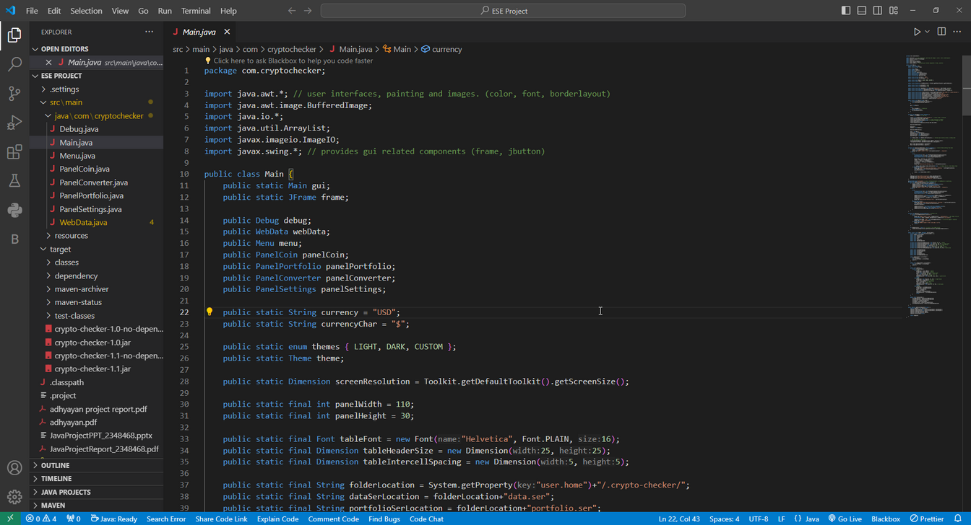
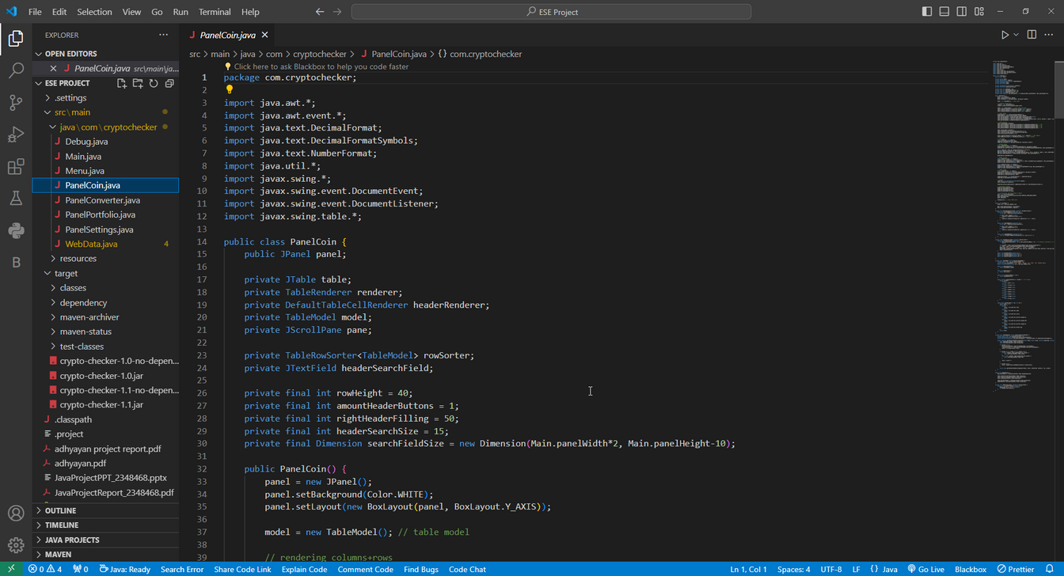

Slide 8
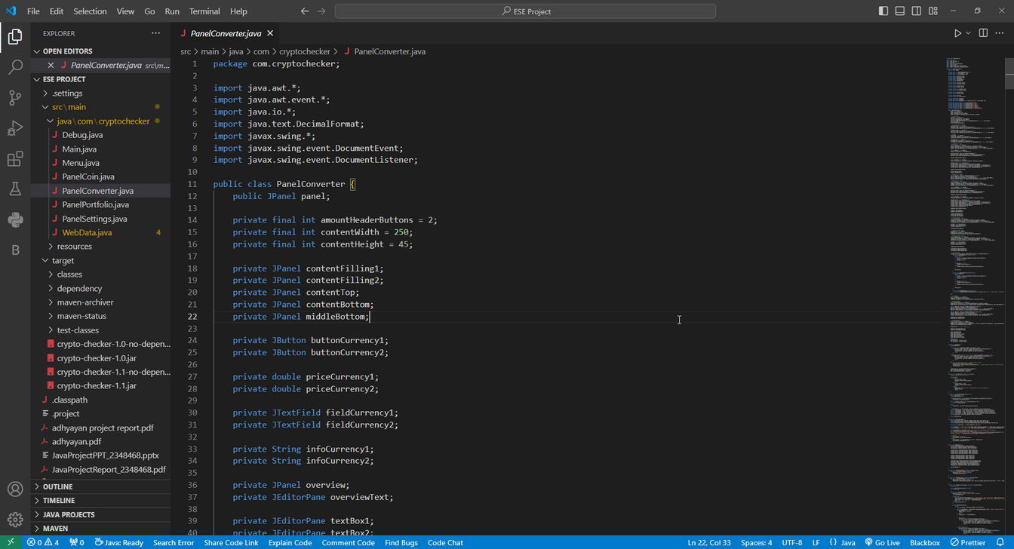
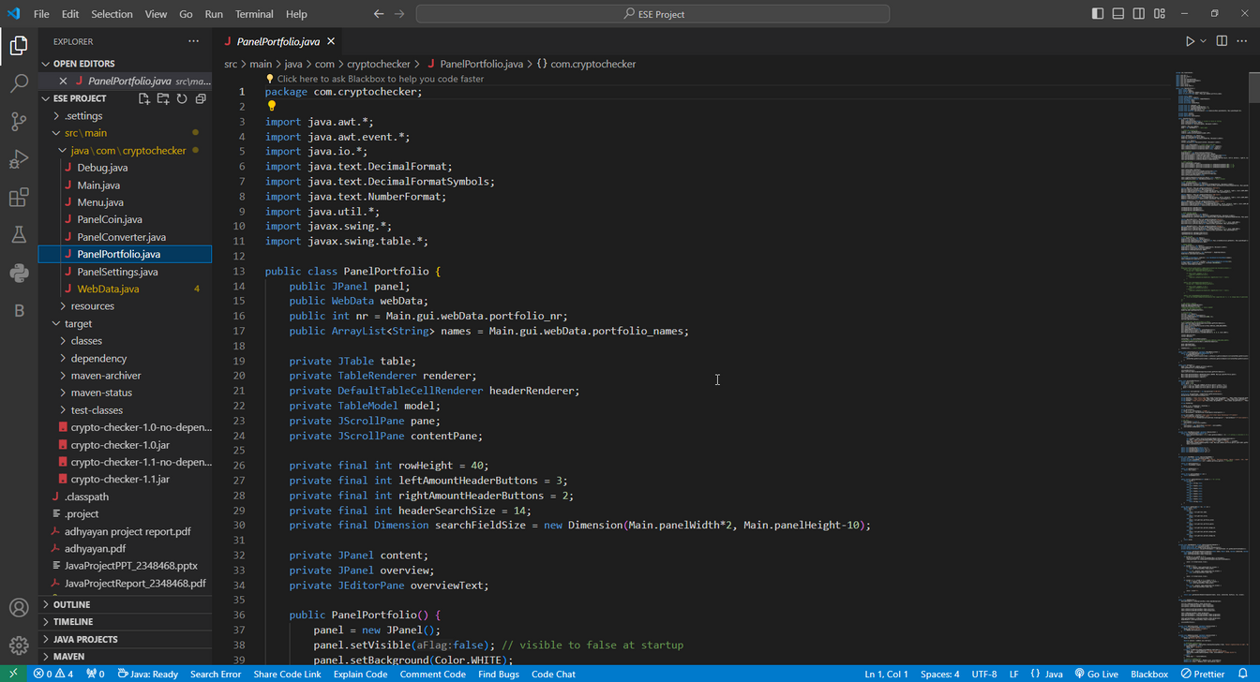

Slide 9

OUTPUT AND VISUALS

Slide 10
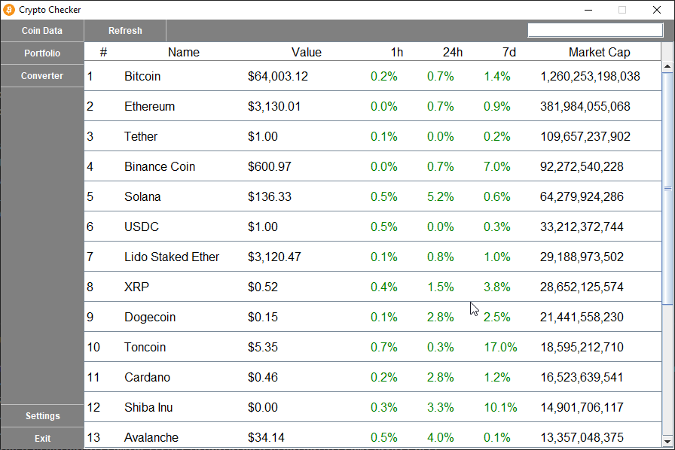
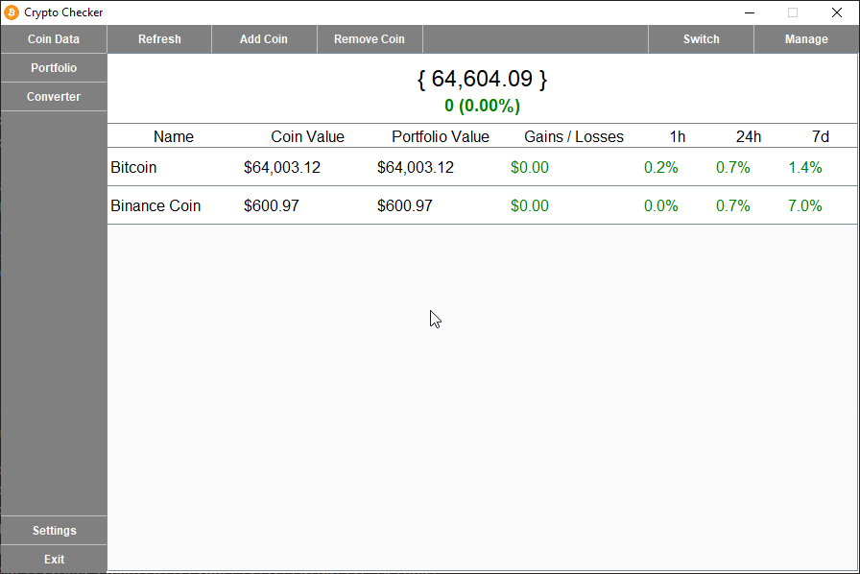

Slide 11
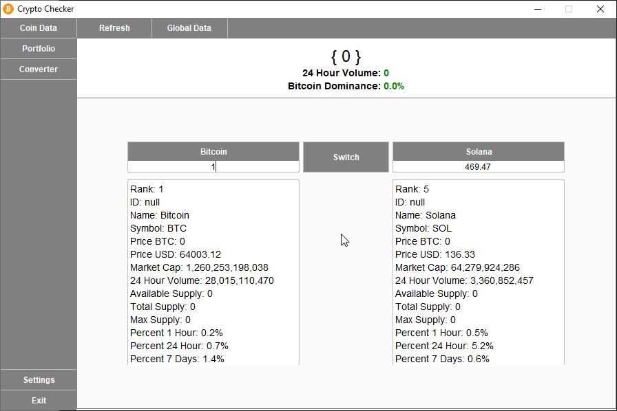
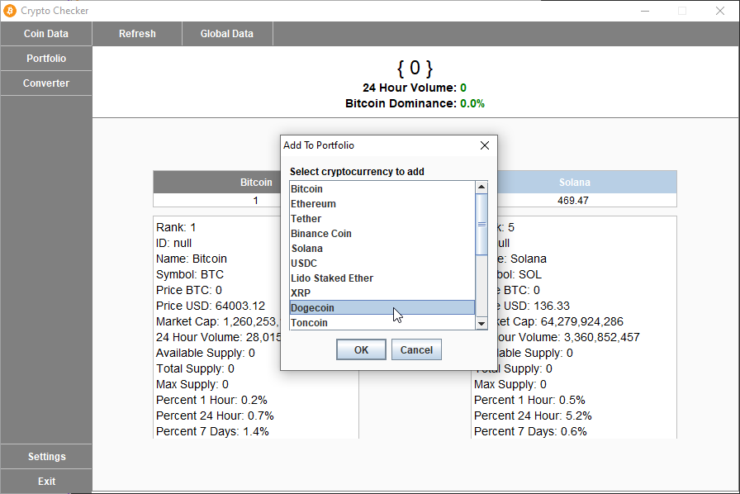

Slide 12
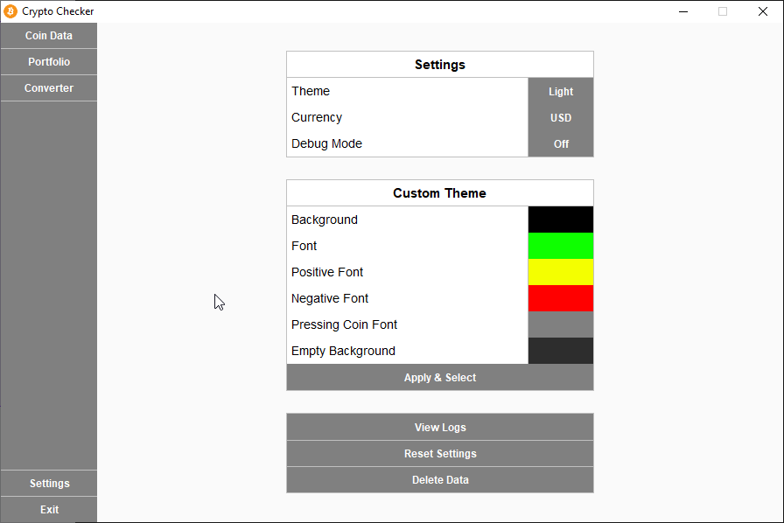
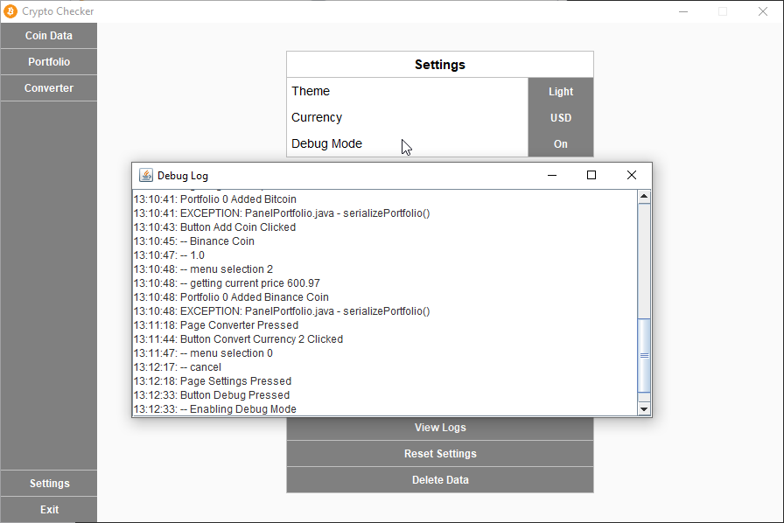

Slide 13
Interesting Observations and Findings
Unexpected correlations between different cryptocurrencies were discovered during the analysis.
Noteworthy patterns in user behavior within the CryptoChecker application shed light on user preferences and trends.
INSIGHTS AND DISCOVERIES
User Engagement Metrics
Examination of user engagement metrics revealed patterns in user activity.
Insights into user preferences and usage patterns were gleaned from user behavior analysis.
Observations on user interaction highlighted popular features and functionalities of CryptoChecker.
Trends Observed in Cryptocurrency Data
Identification of emerging trends like the DeFi boom and NFT craze.
Analysis of historical data correlating Bitcoin's price with economic events.
Prediction of future trends using sentiment analysis and algorithmic trading.

Slide 14

CONCLUSION
Key Findings: Through CryptoChecker, we discovered valuable insights into cryptocurrency trends and user behavior, providing a deeper understanding of the digital asset landscape.
Project Success: The successful implementation of CryptoChecker fulfilled its objectives by empowering users with comprehensive data analysis tools, enabling informed decision-making in the volatile cryptocurrency market.
Lessons Learned: Over the course of this project, we encountered and overcame various challenges, enriching our skills in data analysis and software development. These experiences have provided invaluable lessons for future endeavors.
Future Improvements: Looking ahead, there are opportunities to enhance CryptoChecker further. We aim to refine visualization techniques, expand support for additional cryptocurrencies, and optimize the user interface for a more seamless experience.

Slide 15
Christ University
THANK YOU
Adhyayan Amit Jain
3MDS - B
2348468
adhyayan.amit@msds.christuniversity.in

